Slide 1
PERSONAL FINANCIAL MANAGEMENT for school staff
BY
DR GEORGE WILIAM SEMIVULE. BSc,Dip Ed,MA[EducMan],PhD[Management and Administration]
SENIOR LECTURER
FACULTY OF EDUCATION
NDEJJE UNIVERSITY

Slide 2
Personal finance
By the end of the presentation you would be able to know;
Budgeting
Day-to-day cashflow management
How to save
How to investment
retirement planning,

Slide 3
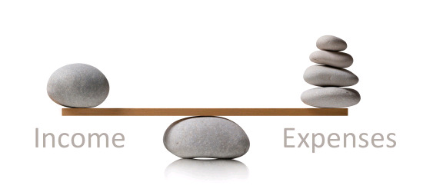
Balancing cash in/ cash out

Slide 4
PRIORITIES | ACTIVITIES/ITEMS
THINGS YOU NEED | Food,cloths,accomodation
THINGS IMPORTANT | Children’s education, Payment of obligations,utilities,taxes,investments
WANTS | Air time (excess), party, drinks ,daily bread,daily milk,Expensive,vacation transport.Expensive cloths,weddings

Slide 5
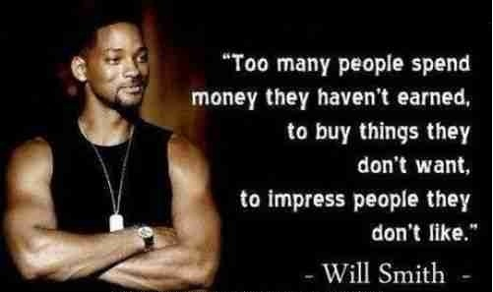

Slide 6
Annual Expenditure on wants
Daily cost of bread = 4500/=
Daily air time= 1500/=
Daily transport excess = 1500/=
Daily Total = 7500/=
Annual total= 365 x 7500=2,737,500/
=~ 3millions

Slide 7
INVESTMENT OPPORTUNITIES LOST
A.Cost of 1 Brick =200/=
Number of bricks that could be bought in annual wants= 2,737,500 ÷ 200=13,687 bricks which can build a three roomed standard house
B. 2,737,500 = to 40 Corrugated iron sheets @ 70,000
C. 2,737,500 = A motor scooter
SIDE HUSSLEs
D. 2,737,500 = Ice cream machine
E. 2,737,500 = Saloon/Pedicure and Manicure
F. 2,737,500 = Mobile money
G. 2,737,500 = Chicken butchery

Slide 8
PERSONAL BUDGETING Why budget?
A Budget helps YOU to manages your finances responsibly by guiding you to;
live within your means[Income=expenses]
keep your debts to a manageable level.
ensure that you will always have enough money for the things you need and the things that are important to you.

Slide 9
MATRIX FOR PERSONAL BUDGET MONTHLY INCOME
Salary[after tax anddeductions]
Savings interest earned
Other sources of income
Total income

Slide 10
i]FIXED EXPENCES
Housing
Utilities
Telephone
Transportation
Credit
Savings
Total fixed expences

Slide 11
ii]VARIABLE EXPENCES
Personal care
Food
Household supplies
Medicine/health
Entertainment
Total Variable Expences

Slide 12


Slide 13
HOW TO SAVE
FOUR SAVING TIPS :
Set up a savings account.[Banks,SACCOs,Insurance etc]
Calculate how much you’ll need to save for retirement/investments and deduct it monthly.
Ask your bank to set up automatic deduction from your salary account and transfer it to your savings account every month.
What you save should only go to investments NOT on monthly expences/obligations.

Slide 14


Slide 15
Investment decision
Questions to be answered.
What sort of investment/business are you going to do?
How much do you know about the business?
(Read ‘The richest man in Babylon’)
What will be the rate of return on investment? (RRI)
How long will it take for the business to break even? (When the INCOME covers the EXPENDITURE)
How long will it take to recover your initial Capital?

Slide 16
Make an investment plan
Plan to;
Invest in your self e.g further studies.
Invest in your spare time (16hrs daily;3 Term holidays).N.B You work for only 8 hours a day
Invest in your spouse and family.
Invest your savings regularly/consistently.
Invest;
(i) short term.
(ii) medium term.
(iii)long term.

Slide 17
Types of investments
Invest in those areas that you are familiar with.( Read ‘The richest man in Babylon”)
Invest in your Spouse (further education, vocational/technical skills etc).This may be your retirement package.
Invest in Compassion (social investment);help others financially.
Have multiple approach/A mix; those that produce; daily returns, weekly returns, monthly returns, semiannual and annual returns.

Slide 18
Multiple investment approach
Daily returns | Bodboda,mobile money,Saloon,
Weekly returns | Taxi,Bodaboda,Lorry,Tipper,Pickup,Fast-Food hub.
Monthly | Dairy,Rentals,
Semi-annual | Fixed deposit,Maize,Potatoes,
Annual returns | Goats,Fruit trees,Bananas, Plantain,Matooke.
Post Annual | Forests/Tree plantations,Stock market, Company Shares.

Slide 19
Principle 1: The Time Value of Money
A shilling received today is worth more than a Shilling received in the future.
Because we can earn interest on money received today, it is better to receive money earlier rather than later.

Slide 20
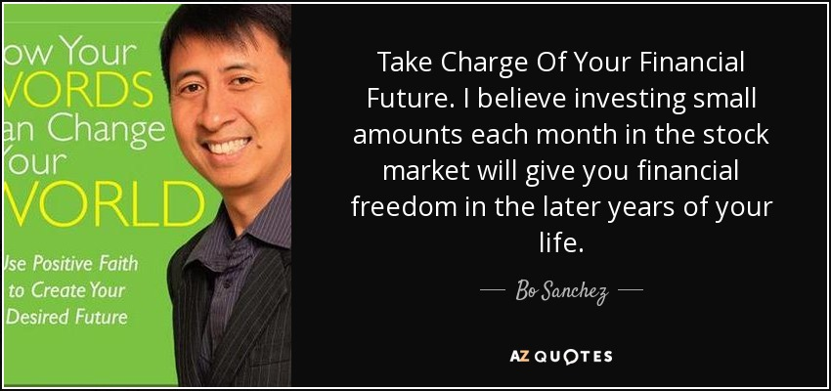

Slide 21
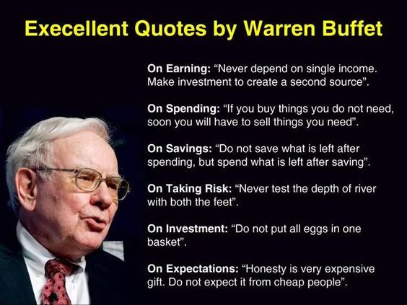

Slide 22
Retirement Plan
The general rule of thumb is to figure out that you will need approximately 80% of your current monthly income in retirement.
Estimate what health care costs could be in retirement.
Save from investments for specifically retirement.
Re-invent/Retool yourself before or after retirement in order to remain relevant

Slide 23


